Slide 1
From BM25 to (Col)BERT to LLMs: Navigating a Maturing Efficiency–Effectiveness Tradeoff Space in Neural IR
Omar Khattab July 2023

Slide 2
Big Picture
The past five years have dramatically transformed the landscape of IR.
This was a year after a massive shift in NLP.
Things are now changing in NLP again, but this time IR can have an even more central impact:
Multi-stage architectures at scale and in user-facing contexts
End-to-end tradeoffs between efficiency and effectiveness

Slide 3
Outline
ColBERT & Connections to Prior Research
ColBERTv2 & PLAID: More efficient late interaction
Benchmarking tradeoffs in IR
The DSPy Framework: multi-stage retrieval-based NLP systems

Slide 4
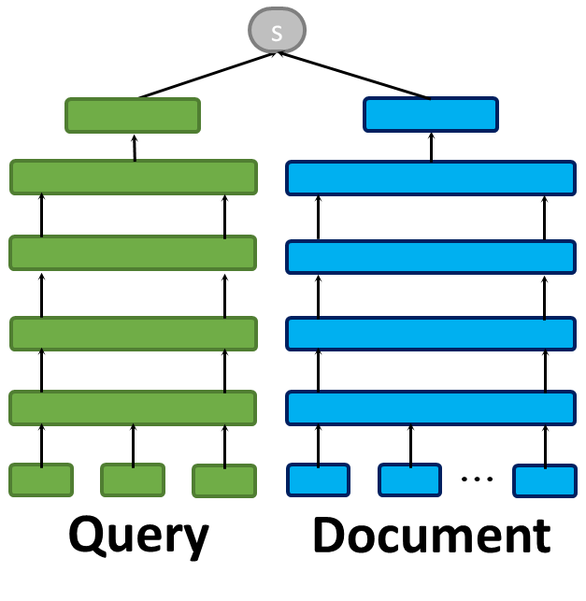
Neural IR: Two Extreme Matching Paradigms
(a) Single-Vector Representations
✔ Independent, Dense Encoding
❌ Coarse-Grained Representation

Slide 5
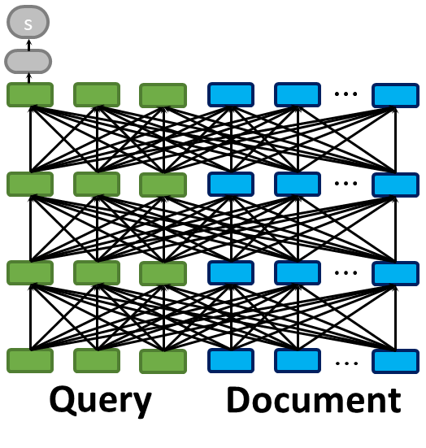
Neural IR: Two Extreme Matching Paradigms
(a) Single-Vector Representations
✔ Independent, Dense Encoding
❌ Coarse-Grained Representation
(b) Cross Encoders
✔ Fine-Grained Interactions
❌ Unscalable Joint Conditioning

Slide 6
ColBERT: Late Interaction
✔ Independent Encoding
✔ Fine-Grained Representations
✔ Scalable Nearest-Neighbor Search
Query
Document
(c) Late Interaction
Omar Khattab and Matei Zaharia. “ColBERT: Efficient and effective passage search via contextualized late interaction over BERT." SIGIR 2020.

Slide 7
ColBERT: Late Interaction
s
$$∑$$
MaxSim
MaxSim
MaxSim
✔ Independent Encoding
✔ Fine-Grained Representations
✔ Scalable Nearest-Neighbor Search
Query
Document
(c) Late Interaction
End-to-End Retrieval over Wikipedia (21M passages) takes 70ms.
Omar Khattab and Matei Zaharia. “ColBERT: Efficient and effective passage search via contextualized late interaction over BERT." SIGIR 2020.

Slide 8
Late Interaction: Real Example of Matching
when did the transformers cartoon series come out?
[…] the animated […] The Transformers […] […] It was released […] on August 8, 1986
when did the transformers cartoon series come out?
[…] the animated […] The Transformers […] […] It was released […] on August 8, 1986
when did the transformers cartoon series come out?
[…] the animated […] The Transformers […] […] It was released […] on August 8, 1986
when did the transformers cartoon series come out?
[…] the animated […] The Transformers […] […] It was released […] on August 8, 1986
when did the transformers cartoon series come out?
[…] the animated […] The Transformers […] […] It was released […] on August 8, 1986

Slide 9
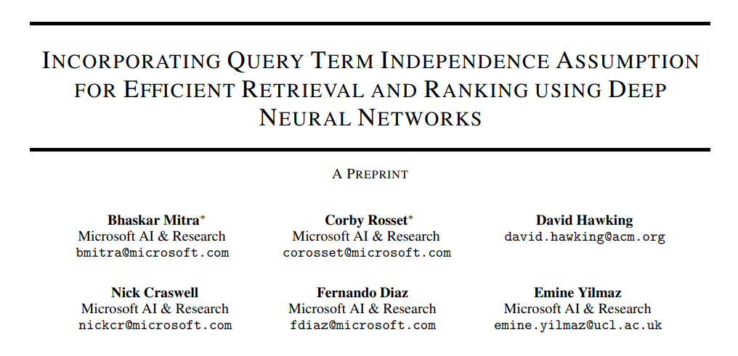
Why is late interaction designed like that? Building on an expansive literature from 1995 to 2019
We start from BERT rerankers and seek some degree of term independence

Slide 10
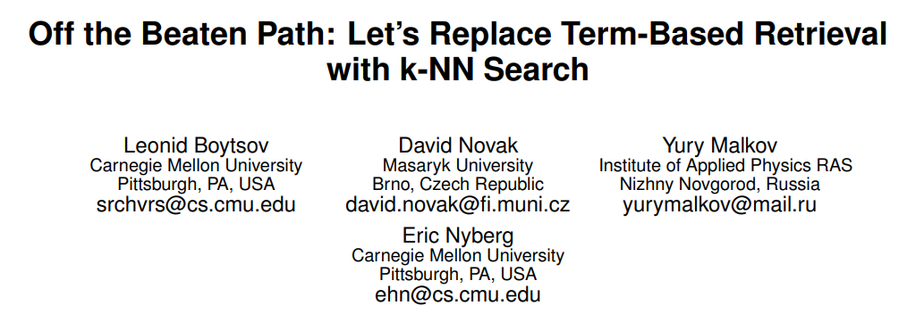
Why is late interaction designed like that? Building on an expansive literature from 1995 to 2019
Specifically, we’ll replace term-based retrieval with vectors *but* keep local term interactions

Slide 11
Why is late interaction designed like that? Building on an expansive literature from 1995 to 2019
And to make this whole thing scale, we’ll rely on a multi-stage architecture within the model itself

Slide 12
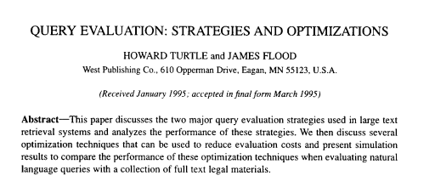
Why is late interaction designed like that? Building on an expansive literature from 1995 to 2019
The first stage will use term upper bounds for pruning!

Slide 13
Why is late interaction designed like that? Building on an expansive literature from 1995 to 2019
But we’ll use kNN search optimizations to make this scale with dense vectors.

Slide 14
Top-$k$ Retrieval Strategies
The IR literature includes many top-k retrieval strategies
Common Goal: To minimize latency by reducing…
# of documents selected | # of postings accessed
# of scores computed | overhead of all this!

Slide 15
Top-$k$ Retrieval Strategies
Top-k
Retrieved
Documents
Query
Top-k Retrieval Strategy
Inverted
Index
Bag-of-Words
Ranking Model
(e.g., BM25)
Upper Bounds

Slide 16
Top-$k$ Retrieval Strategies: DAAT
Most safe strategies follow a Document-At-A-Time (DAAT) paradigm
Example Query: “protein quaternary structure definition”
protein
quaternary
structure
definition

Slide 17
Top-$k$ Retrieval Strategies: DAAT
Document ID: #13
Score: RankingModel(definition, #13)
Example Query: “protein quaternary structure definition”
protein
quaternary
structure
definition

Slide 18
Top-$k$ Retrieval Strategies: DAAT
Document ID: #21
Score: RankingModel(protein, #21) + RankingModel(structure, #21) + RankingModel(definition, #21)
Example Query: “protein quaternary structure definition”
protein
quaternary
structure
definition

Slide 19
Top-$k$ Retrieval Strategies: DAAT
Document ID: #23
Score: RankingModel(quaternary, #21) + RankingModel(definition, #23)
Example Query: “protein quaternary structure definition”
protein
quaternary
structure
definition

Slide 20
Top-$k$ Retrieval Strategies: Pruning
Since we seek only the top-$k$ results, pruning is essential
Pre-compute upper bounds (UBs) on term contributions
Maintain a top-$k$ heap with a threshold $θ$
Existing DAAT strategies fall under two “worlds”
WAND (Broder et al., 2003): pessimistic, cautious pruning heuristic
MaxScore (Turtle & Flood, 1995): eager, hard-and-fast pruning heuristic

Slide 21
4.6
protein
Document ID: ?
Threshold $θ$: 7.9
9.5
quaternary
3.2
structure
1.9
definition
WAND
Re-sort terms every step by next doc ID
Use UBs to identify the pivot term
Pro: UBs used tightly per step
Con: Control flow very pessimistic
MaxScore
Pre-sort all terms by UB
Only process “essential” terms
Pro: Control flow very lightweight
Con: Evaluation too eager

Slide 22
4.6
protein
Document ID: ?
Threshold $θ$: 7.9
9.5
quaternary
3.2
structure
1.9
definition
WAND
MaxScore
3.2
structure
1.9
definition
4.6
protein
3.2
structure
1.9
definition
4.6
protein
9.5
quaternary
9.5
quaternary

Slide 23
Block-Max Structures
WAND & MaxScore variants employ UBs at a finer granularity
Postings-Oriented Blocks (Ding & Suel, 2011; Chakrabarti et al., 2011)
Pro: Simple
Con: Unaligned blocks; complex access logic!
DocID-Oriented (Dimopoulos et al., 2013)
Pro: aligned blocks; very fast access!
Con: Potential high footprint for sparse terms

Slide 24
So, how can ColBERT do interaction at scale? A naïve, but pretty good answer: TAAT (Term-At-A-Time scoring)

Slide 25
ColBERT: End-to-End Retrieval
Document IDs
#1
#45,436
#935,765
#2,689,357
#7,769,374

Slide 26
ColBERT: End-to-End Retrieval
Document IDs
#1
#45,436
#935,765
#2,689,357
#7,769,374
Embeddings

Slide 27
ColBERT: End-to-End Retrieval
Document IDs
#1
#45,436
#935,765
#2,689,357
#7,769,374
Embeddings
Indexed for fast vector-similarity search.
We use Facebook’s faiss.

Slide 28
ColBERT: End-to-End Retrieval
Document IDs
#1
#45,436
#935,765
#2,689,357
#7,769,374
Embeddings

Slide 29
ColBERT: End-to-End Retrieval
Document IDs
#1
#45,436
#935,765
#2,689,357
#7,769,374
Embeddings
Query

Slide 30
ColBERT: End-to-End Retrieval
Document IDs
#1
#45,436
#935,765
#2,689,357
#7,769,374
Embeddings
Query

Slide 31
ColBERT: End-to-End Retrieval
Document IDs
#1
#45,436
#935,765
#2,689,357
#7,769,374
Embeddings
Query

Slide 32
ColBERT: End-to-End Retrieval
Document IDs
#1
#45,436
#935,765
#2,689,357
#7,769,374
Embeddings
Query

Slide 33
ColBERT: End-to-End Retrieval
Document IDs
#1
#45,436
#935,765
#2,689,357
#7,769,374
Embeddings
Query

Slide 34
ColBERT: End-to-End Retrieval
Document IDs
#1
#45,436
#935,765
#2,689,357
#7,769,374
Embeddings

Slide 35
ColBERT: End-to-End Retrieval
Document IDs
#1
#45,436
#935,765
#2,689,357
#7,769,374
Embeddings

Slide 36
ColBERT: End-to-End Retrieval
s
$$∑$$
MaxSim
MaxSim
MaxSim
Document
(pre-computed)
Query
Document IDs
#1
#45,436
#935,765
#2,689,357
#7,769,374
Embeddings

Slide 37
ColBERT: End-to-End Retrieval
s
$$∑$$
MaxSim
MaxSim
MaxSim
Document
(pre-computed)
Query
Document IDs
#1
#45,436
#935,765
#2,689,357
#7,769,374
Embeddings

Slide 38
ColBERT: End-to-End Retrieval
s
$$∑$$
MaxSim
MaxSim
MaxSim
Document
(pre-computed)
Query
Document IDs
#1
#45,436
#935,765
#2,689,357
#7,769,374
Embeddings

Slide 39
ColBERT: End-to-End Retrieval
s
$$∑$$
MaxSim
MaxSim
MaxSim
Document
(pre-computed)
Query
Document IDs
#1
#45,436
#935,765
#2,689,357
#7,769,374
Embeddings

Slide 40
Late interaction delivers large gains…

Slide 41
Late interaction delivers large gains…
 | Passage Ranking
Model | MS MARCO MRR@10
BM25 | 18.7
DPR | 31.1
ANCE | 33.0
ColBERT[QA] | 36.0 / 37.5
DPR and ANCE result figures from the respective papers. DPR on MS MARCO was evaluated by the ANCE authors.

Slide 42
Late interaction delivers large gains…
 | Passage Ranking | Open-Domain QA Retrieval over Wikipedia’18 | TriviaQA | SQuAD
Model | MS MARCO MRR@10 | NaturalQs Success@20 | TriviaQA Success@20 | Open-SQuAD Success@20
BM25 | 18.7 | 64.0 | 77.3 | 71.4
DPR | 31.1 | 79.4 | 79.9 | 71.5
ANCE | 33.0 | 81.9 | 80.3 | -
ColBERT[QA] | 36.0 / 37.5 | 85.3 | 85.6 | 83.7
DPR and ANCE result figures from the respective papers. DPR on MS MARCO was evaluated by the ANCE authors.

Slide 43
Late interaction delivers large gains…
 | Passage Ranking | Open-Domain QA Retrieval over Wikipedia’18 | TriviaQA | SQuAD
Model | MS MARCO MRR@10 | NaturalQs Success@20 | TriviaQA Success@20 | Open-SQuAD Success@20
BM25 | 18.7 | 64.0 | 77.3 | 71.4
DPR | 31.1 | 79.4 | 79.9 | 71.5
ANCE | 33.0 | 81.9 | 80.3 | -
ColBERT[QA] | 36.0 / 37.5 | 85.3 | 85.6 | 83.7
And the gaps are often larger when there’s a domain shift or a challenging downstream task!

Slide 44
But advanced supervision strategies can help “simpler” models catch up with vanilla ColBERT!
 | Passage Ranking | Open-Domain QA Retrieval over Wikipedia’18 | TriviaQA | SQuAD
Model | MS MARCO MRR@10 | NaturalQs Success@20 | TriviaQA Success@20 | Open-SQuAD Success@20
BM25 | 18.7 | 64.0 | 77.3 | 71.4
DPR | 31.1 | 79.4 | 79.9 | 71.5
ANCE | 33.0 | 81.9 | 80.3 | -
ColBERT[QA] | 36.0 / 37.5 | 85.3 | 85.6 | 83.7

Slide 45
But advanced supervision strategies can help “simpler” models catch up with vanilla ColBERT!
 | Passage Ranking | Open-Domain QA Retrieval over Wikipedia’18 | TriviaQA | SQuAD
Model | MS MARCO MRR@10 | NaturalQs Success@20 | TriviaQA Success@20 | Open-SQuAD Success@20
BM25 | 18.7 | 64.0 | 77.3 | 71.4
DPR | 31.1 | 79.4 | 79.9 | 71.5
ANCE | 33.0 | 81.9 | 80.3 | -
ColBERT[QA] | 36.0 / 37.5 | 85.3 | 85.6 | 83.7
SPLADEv2 | 36.8 | - | - | -
RocketQAv2 | 38.8 | 83.7 | - | -

Slide 46
But advanced supervision strategies can help “simpler” models catch up with vanilla ColBERT!
And ColBERT’s index is an order of magnitude larger, at 650 GB for Wikipedia!
 | Passage Ranking | Open-Domain QA Retrieval over Wikipedia’18 | TriviaQA | SQuAD
Model | MS MARCO MRR@10 | NaturalQs Success@20 | TriviaQA Success@20 | Open-SQuAD Success@20
BM25 | 18.7 | 64.0 | 77.3 | 71.4
DPR | 31.1 | 79.4 | 79.9 | 71.5
ANCE | 33.0 | 81.9 | 80.3 | -
ColBERT[QA] | 36.0 / 37.5 | 85.3 | 85.6 | 83.7
SPLADEv2 | 36.8 | - | - | -
RocketQAv2 | 38.8 | 83.7 | - | -
Can we recover ColBERT’s large quality advantage and reduce its footprint by an order of magnitude?

Slide 47
ColBERTv2: Residual Compression
Vectors corresponding to each sense of a word cluster closely, with minor but important variation due to context!

Slide 48
ColBERTv2: Residual Compression
Vectors corresponding to each sense of a word cluster closely, with minor but important variation due to context!

Slide 49
ColBERTv2: Residual Compression
Indexing clusters a sample of token vectors. Then, it represents each vector by storing its cluster ID and a 1-bit delta for each dimension. This can consume as little 20 bytes per vector.
Read the paper for details of efficient indexing and retrieval!
 | MS MARCO Passage Ranking | MS MARCO Passage Ranking
Model | Storage | MRR@10 | Recall@50
ColBERT v1 | 154 GB | 36.2 | 82.1
+ 2 bit residual compression (6x) | 25 GB | 36.2 | 82.3
+ 1 bit residual compression (10x) | 16 GB | 35.5 | 81.6

Slide 50
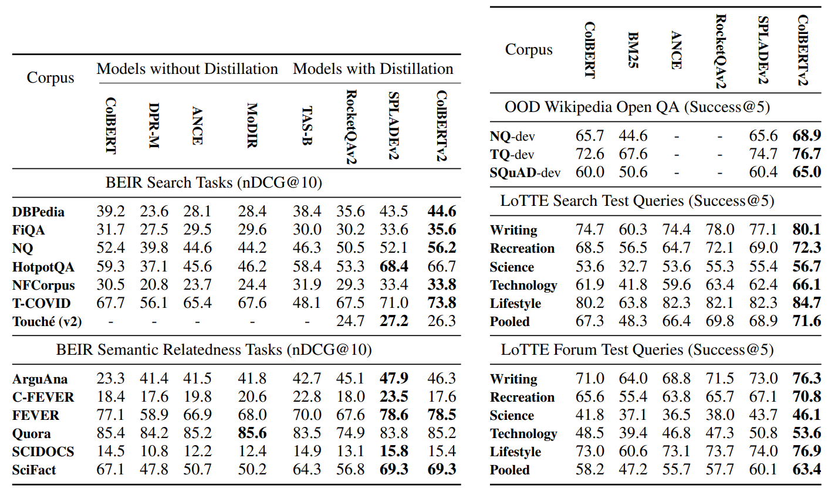
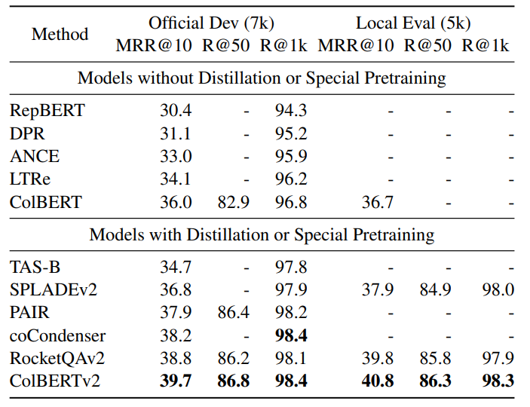
ColBERTv2 uses denoised training and residual compression to re-emerge more effective & lightweight

Slide 51
ColBERTv2 uses denoised training and residual compression to re-emerge more effective & lightweight
… while reducing the index size 6—10x, encoding Wikipedia in 65—110 GB.
… and supporting efficient search, with only 10s—100s of ms of latency per query

Slide 52
ColBERTv2: Denoised Training
Vanilla ColBERT was trained with <query, positive, negative> triples
Negatives are often unlabeled and can be false negatives!
Emerging solution in the literature (e.g., RocketQAv2, SPLADEv2) Train the model to mimic the output scores of a cross encoder

Slide 53
ColBERTv2: Denoised Training
Vanilla ColBERT was trained with <query, positive, negative> triples
Negatives are often unlabeled and can be false negatives!
Emerging solution in the literature (e.g., RocketQAv2, SPLADEv2) Train the model to mimic the output scores of a cross encoder
But will this proportionally benefit ColBERT given its more rigid late-interaction modeling? Yes! See details in paper!

Slide 54
The LoTTE Benchmark: Long-Tail Topic-stratified Retrieval Evaluation
LoTTE focuses on out-of-domain retrieval with natural and long-tail queries
It also includes distinct dev and test distributions, divided per topic

Slide 56
ColBERTv2 and LoTTE are available at github.com/stanford-futuredata/ColBERT
… while reducing the index size 6—10x and maintaining 10s—100s of ms latency

Slide 57
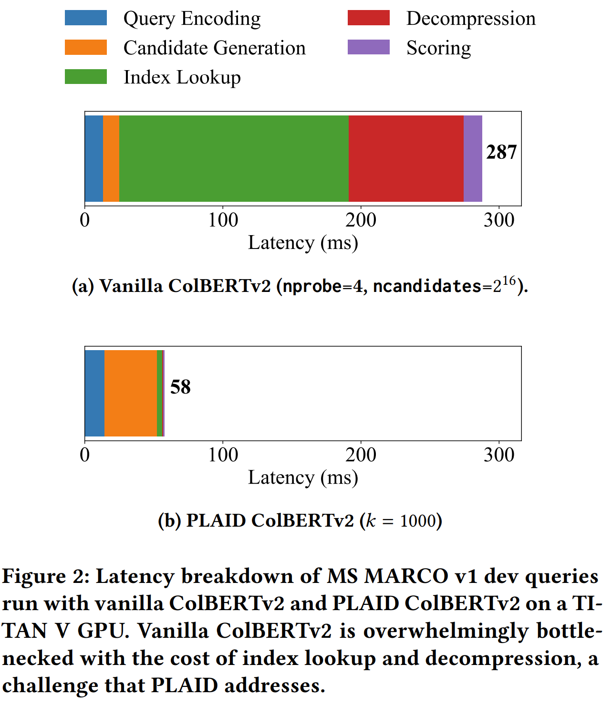
What about latency and hardware requirements?

Slide 58
ColBERTv2 + PLAID: Centroid Interaction Search
ColBERTv2 scores can be decomposed into the interaction of query vectors with the centroids. And then you can add the residuals.
* PLAID = Performance-optimized LAte Interaction
But there’s only a fixed set of centroids, typically under a million. What if we score each document as a bag of centroid IDs?
We find that the top results from this set reliably contain the top-k of ColBERTv2.

Slide 59
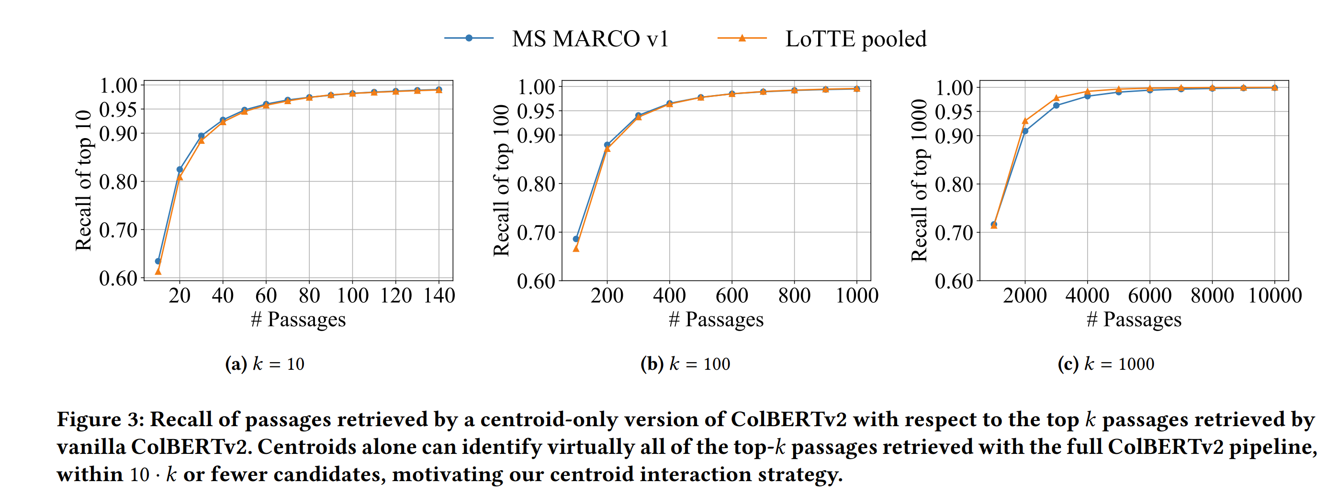
Centroids alone identify strong candidates

Slide 60
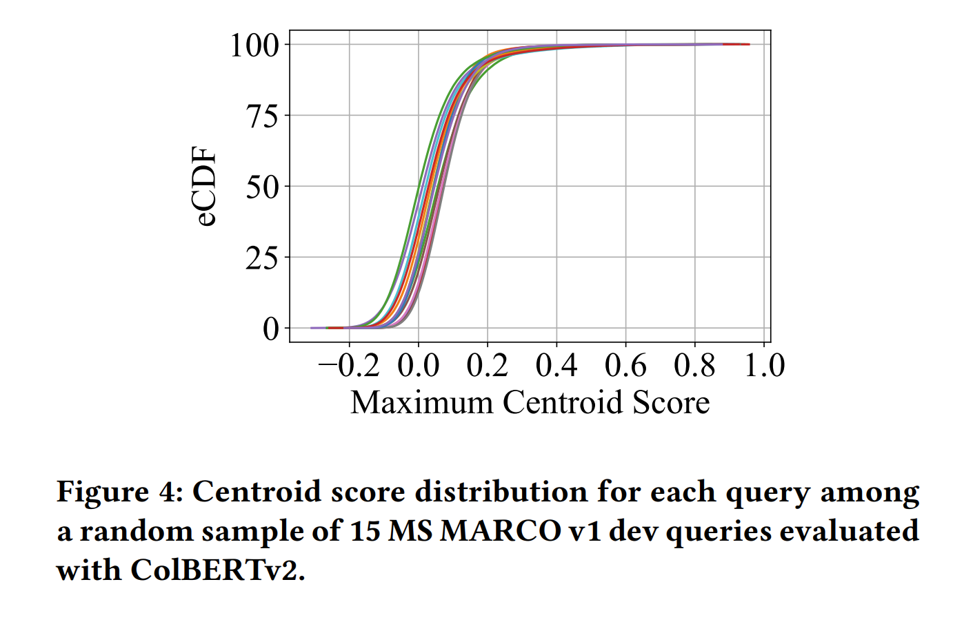
Not all centroids are important, given a query

Slide 61
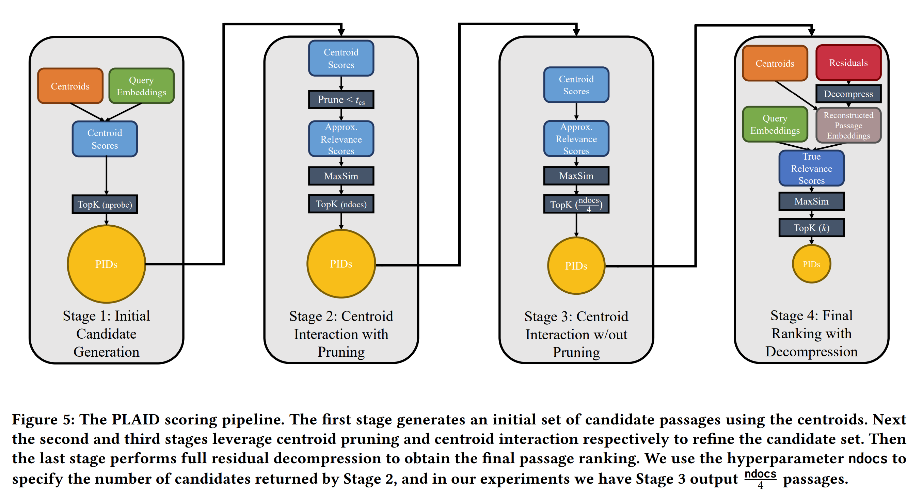
Overall PLAID pipeline

Slide 62
With PLAID, ColBERTv2 scales its state-of-the-art quality to massive datasets!
Model | MS MARCO
# of tokens | 450M
# of passages | 9M
Index Size | 25 GB (2-bit)
GPU Search Latency | 15 ms
CPU Search Latency | 45 ms

Slide 63
With PLAID, ColBERTv2 scales its state-of-the-art quality to massive datasets!
Model | MS MARCO | Wikipedia
# of tokens | 450M | 2.1B
# of passages | 9M | 21M
Index Size | 25 GB (2-bit) | 110 GB (2-bit)
GPU Search Latency | 15 ms | -
CPU Search Latency | 45 ms | 67 ms

Slide 64
With PLAID, ColBERTv2 scales its state-of-the-art quality to massive datasets!
Model | MS MARCO | Wikipedia | MS MARCO “v2”
# of tokens | 450M | 2.1B | 9B
# of passages | 9M | 21M | 140M
Index Size | 25 GB (2-bit) | 110 GB (2-bit) | 200 GB (1-bit)
GPU Search Latency | 15 ms | - | 48 ms
CPU Search Latency | 45 ms | 67 ms | 136 ms
* These latencies exclude query encoding with BERT.
With ONNX, single-digit millisecond latencies are achievable for short sequences on CPU.

Slide 65
With PLAID, ColBERTv2 scales its state-of-the-art quality to massive datasets!
Model | MS MARCO | Wikipedia | MS MARCO “v2”
# of tokens | 450M | 2.1B | 9B
# of passages | 9M | 21M | 140M
Index Size | 25 GB (2-bit) | 110 GB (2-bit) | 200 GB (1-bit)
GPU Search Latency | 15 ms | - | 48 ms
CPU Search Latency | 45 ms | 67 ms | 136 ms
These are full-corpus retrieval latencies. For MS MARCO v2, the model probes 70k candidate passages per query! If you already have 7k candidates with high recall, search could be an order-of-magnitude faster.
* These latencies exclude query encoding with BERT.
With ONNX, single-digit millisecond latencies are achievable for short sequences on CPU.

Slide 66
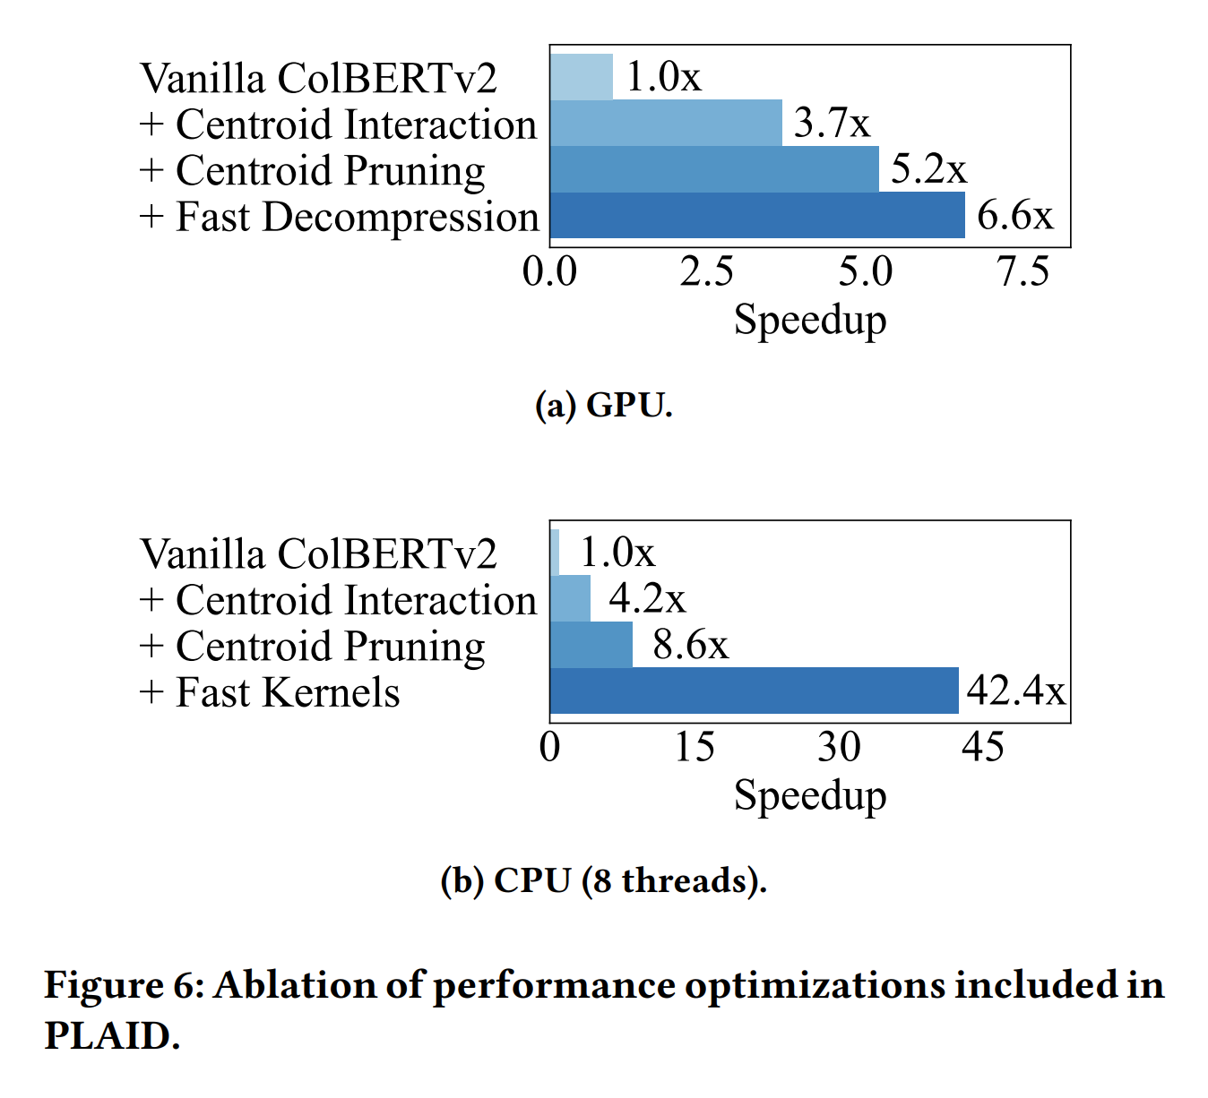
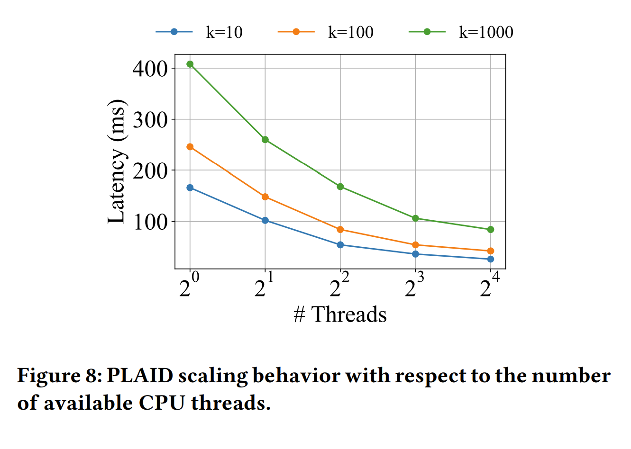

Slide 67
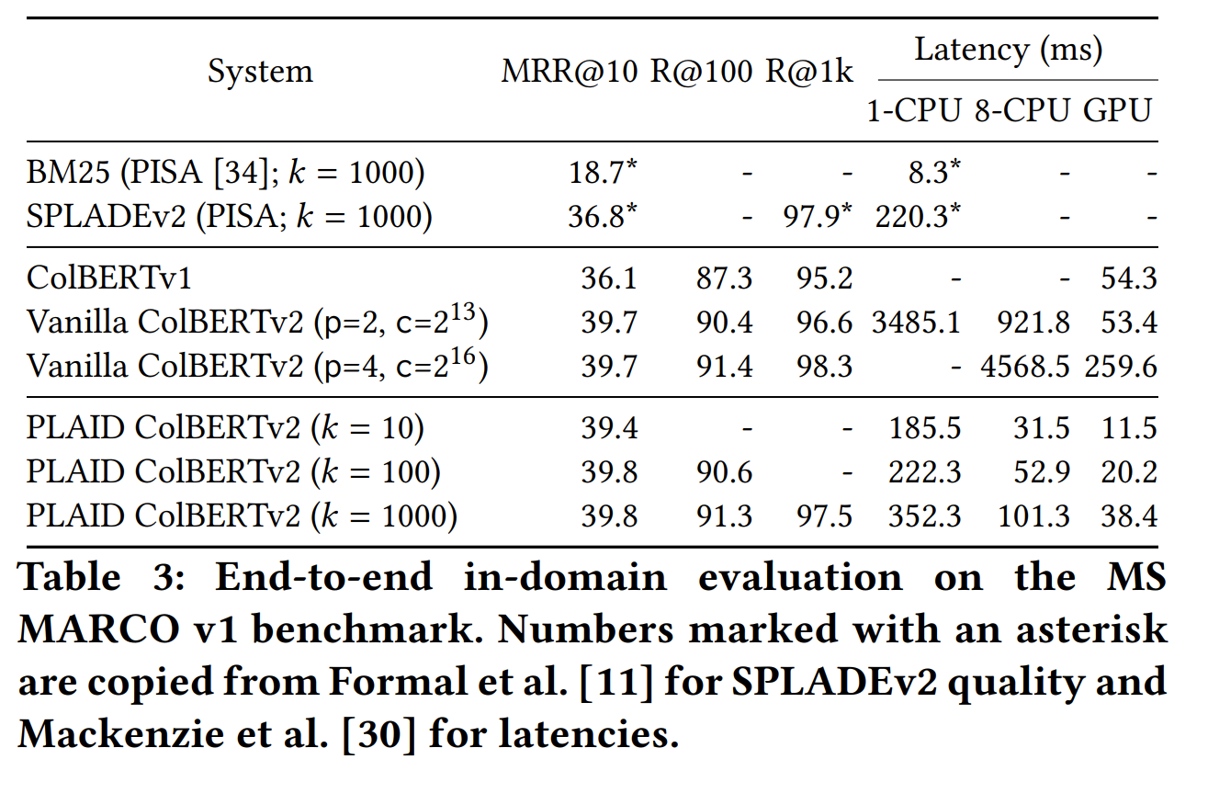

Slide 68
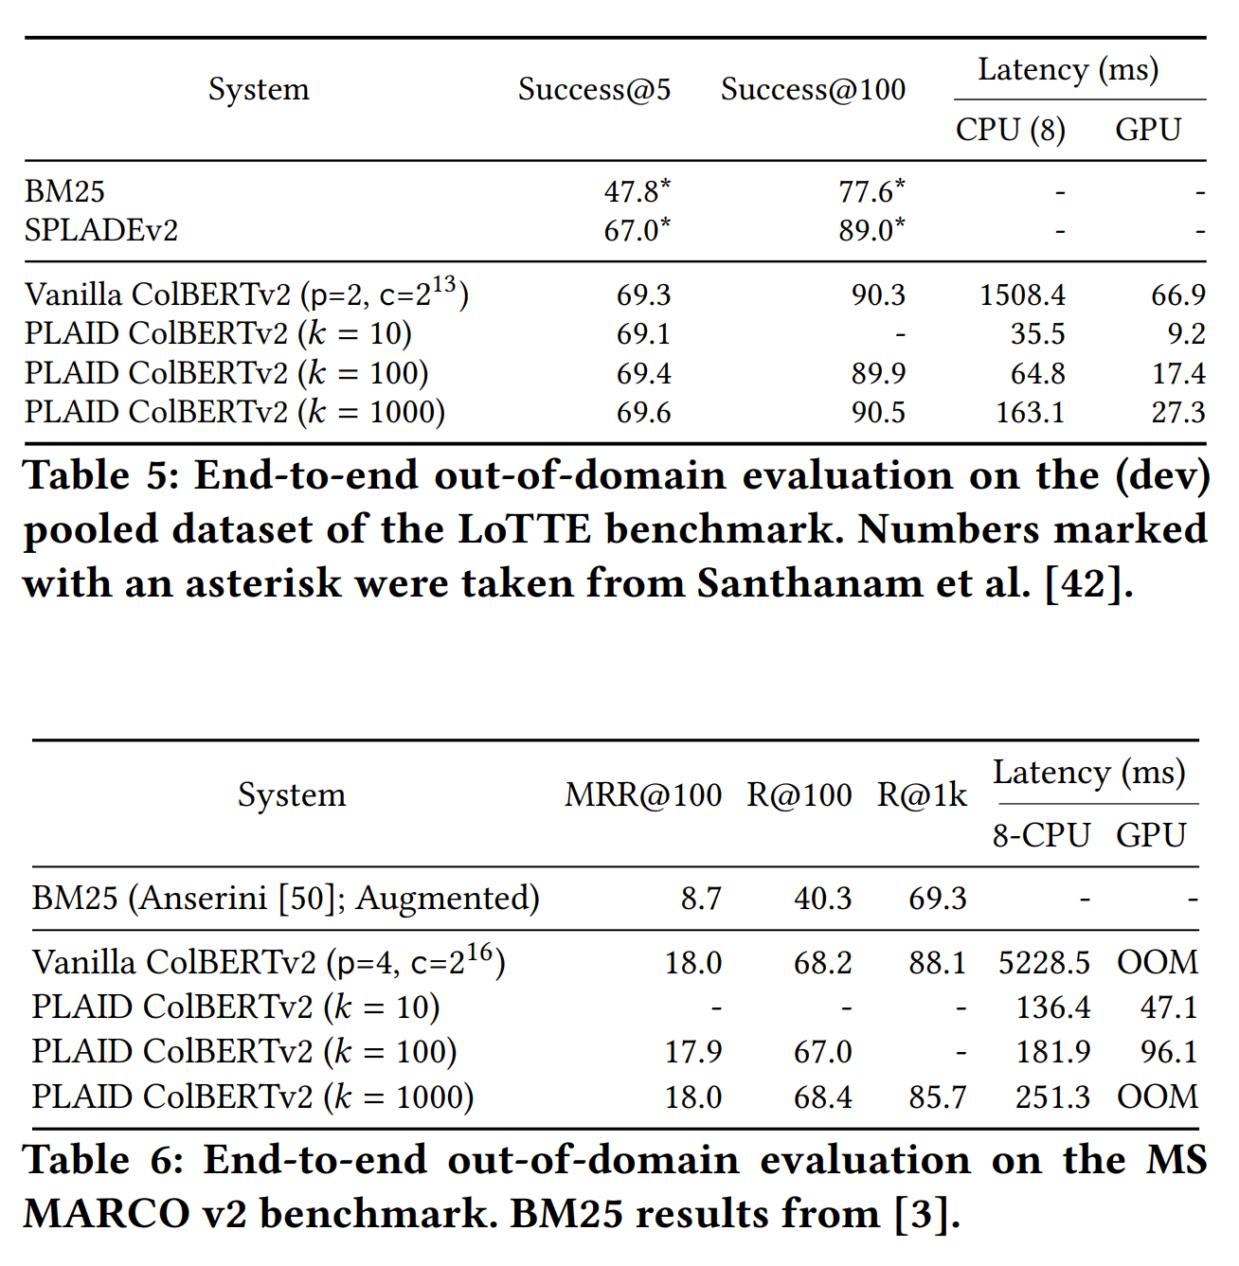

Slide 69
PLAID and ColBERTv2 (and LoTTE, ColBERT-QA, Baleen, and others) are available at github.com/stanford-futuredata/ColBERT
… while reducing the index size 6—10x and maintaining 10s of ms latency, even on CPU only

Slide 70
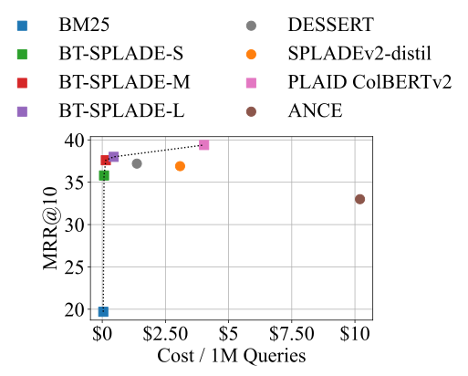
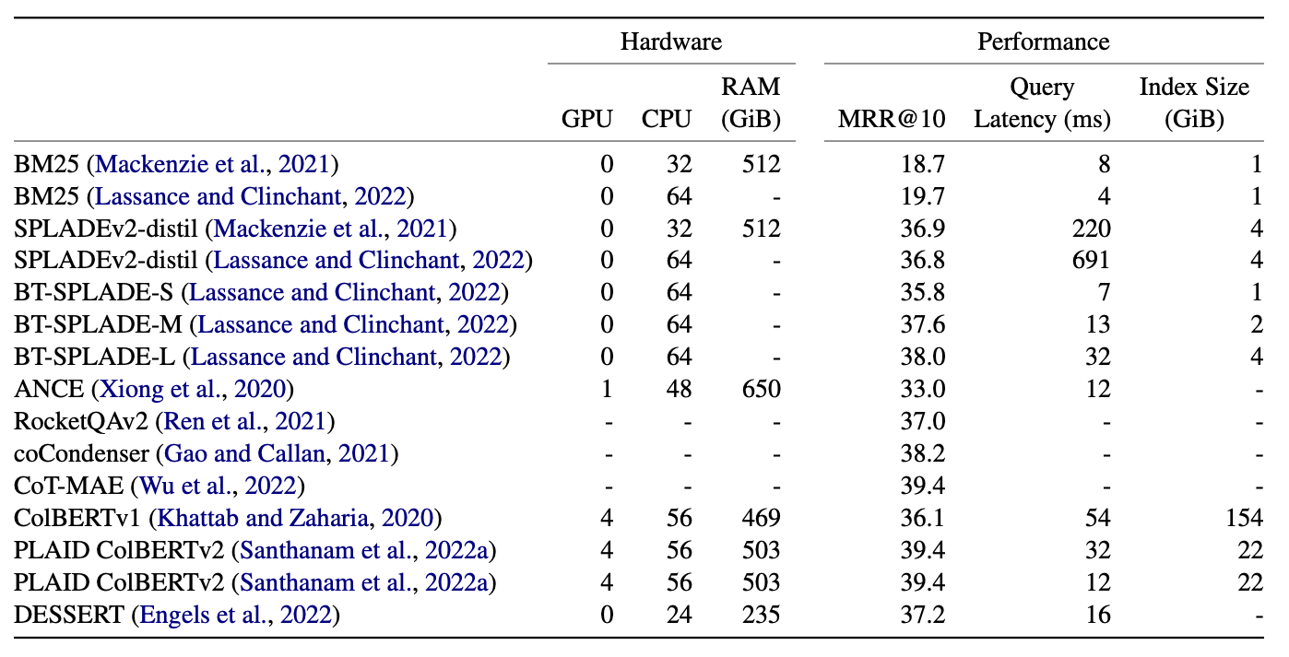
Despite all of this attention to efficiency, popular IR/ML leaderboards generally focus on quality
While many of us report efficiency metrics, it’s not obvious how to standardize these comparisons.

Slide 71
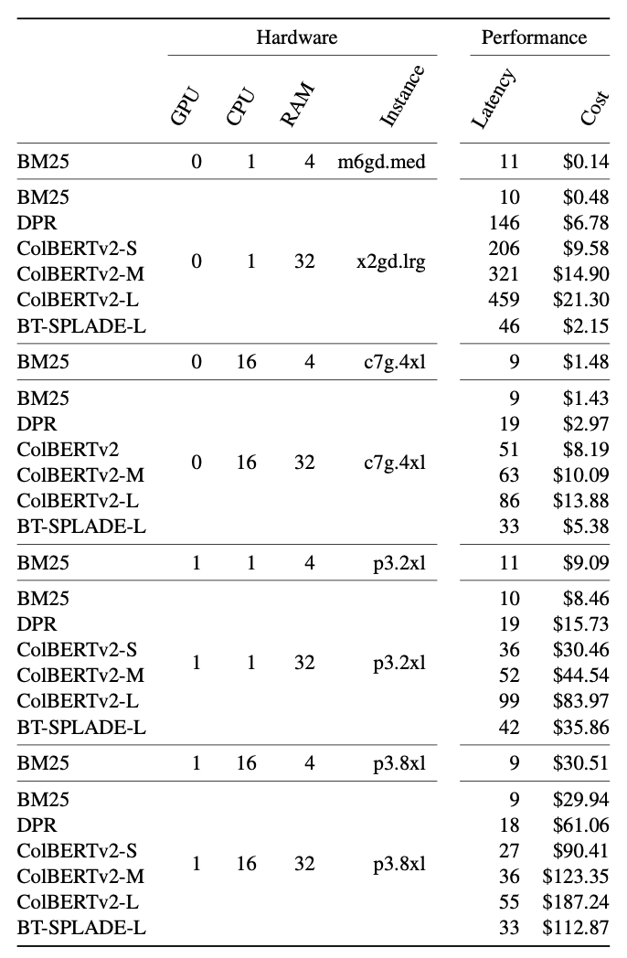
Systematic evaluation reveals complex trade-offs
We systematically evaluate BM25, DPR, ColBERTv2, and BT-SPLADE
We fix an AWS cloud instance per experiment: GPU? CPU? RAM?
We measure latency and cost to run 1 million queries

Slide 72
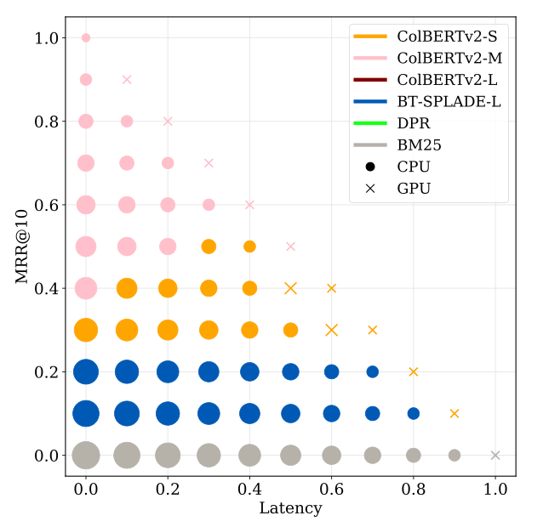
Dynascoring enables flexible comparisons
Dynascoring assigns weights to each metric, distilling to a single holistic score
Weighing accuracy, latency, and cost differently for our MS MARCO evaluation changes the optimal system

Slide 73
Recommendations for future leaderboards
Fix evaluation environment(s). We recommend public cloud instances for consistent specs *and* realistic $$ cost estimates.
Include a comprehensive set of metrics. Evaluation metrics should span both effectiveness and efficiency.
Use Dynascoring to compare systems. Assign (sets of) weights for each metric and distill them to a single score, per tier.
Code: https://github.com/primeqa/primeqa/tree/main/extensions/ir_benchmarking

Slide 74
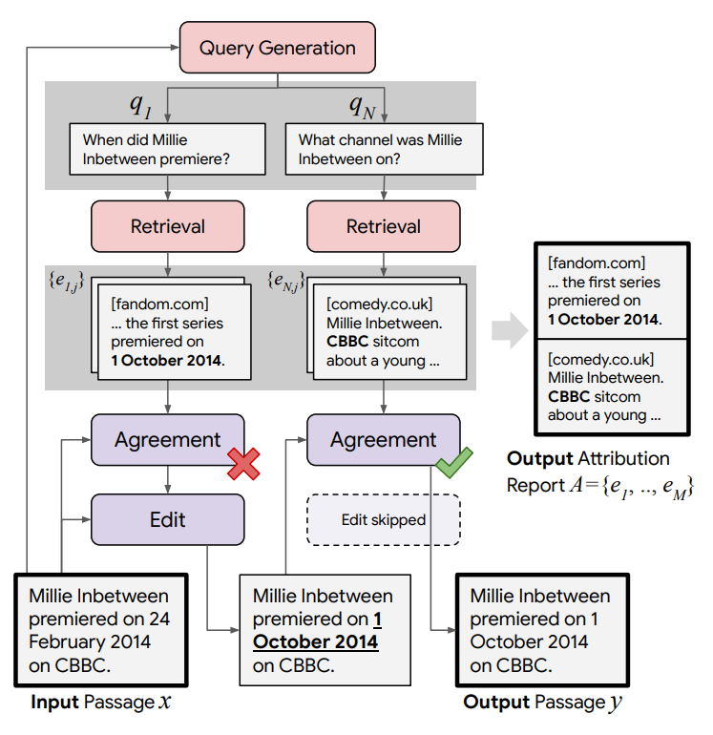
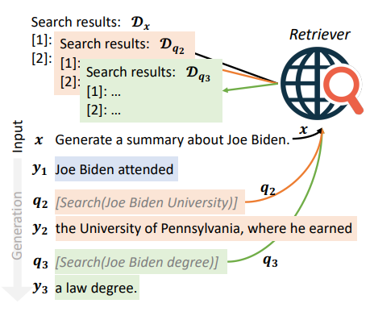
Post neural retrievers, multi-stage architectures are making a comeback – and they look quite different this time
RARR — a pipeline of hand-prompted LLMs & a retriever (2023)
Baleen — a pipeline of finetuned LMs & retrievers (2021)
ColBERT-PRF & CWPRF: Dense Query Expansion pipelines (2023 & 2023)
FLARE — a pipeline of hand-prompted LLMs & a retriever (2023)
Khattab et al. Baleen: Robust Multi-Hop Reasoning at Scale via Condensed Retrieval (NeurIPS 2021, Spotlight)
Gao et al. RARR: Researching and Revising What Language Models Say, Using Language Models (ACL 2023)
Jiang et al. FLARE: Active Retrieval Augmented Generation (arxiv 2023)
Wang et al. Effective Contrastive Weighting for Dense Query Expansion (ACL 2023)

Slide 75
But building effective and efficient pipelines isn’t easy…
Pipeline prompts are extremely fragile and non-transferable.
Pipeline finetunes are very complicated!
Stage latency adds up, and most may invoke LLMs.
Context = dsp.Type(desc='sources with relevant facts')
Question = dsp.Type(desc='question to be answered')
Answer = dsp.Type(desc='a short sentence')
ShortAnswer = dsp.signature('answer a question',
context=Context, question=Question, answer=Answer)
class Baleen(dsp.Module):
def __init__(self):
self.generate_query = dsp.predict(SearchQuery)
self.generate_summary = dsp.predict(SearchSummary)
self.generate_answer = dsp.predict(ShortAnswer)
def forward(self, question: str, max_hops=4):
context = []
for _ in range(max_hops):
query = self.generate_query(context, question)
passages = dsp.search(query.query, k=7).passages
summary = self.generate_summary(context, question, passages)
context.append(summary.summary)
answer = self.generate_answer(context, question)
return dsp.Prediction(context=context, answer=answer)
https://github.com/stanfordnlp/dsp
Come to my talk on the DSPy framework at REML.

Slide 76
Special thanks to…
Keshav Santhanam
Jon Saad-Falcon
Antonio Mallia
Sebastian Hofstatter
Martin Franz, Avi Sil, & the rest of IBM Research AI Team
And many others…
Tamer Elsayed
Mohammad Hammoud
Chris Potts
Matei Zaharia

Slide 77
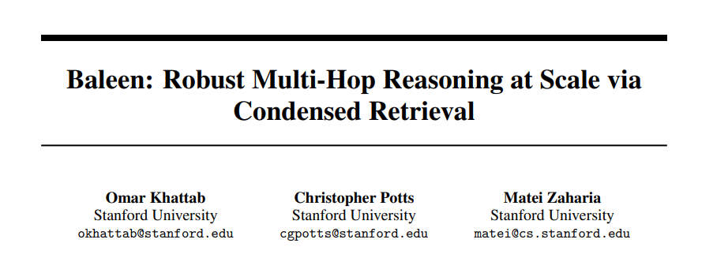
Papers Discussed Today
github.com/stanford-futuredata/ColBERT

